Slide 1
20ITE03-USER INTERFACE DESIGN Title : online ADMISSION management system
Submitted by,
KAVIN T-20ITR048
KAVIPRIYA M-20ITR049

Slide 2

HOME PAGE

Slide 3
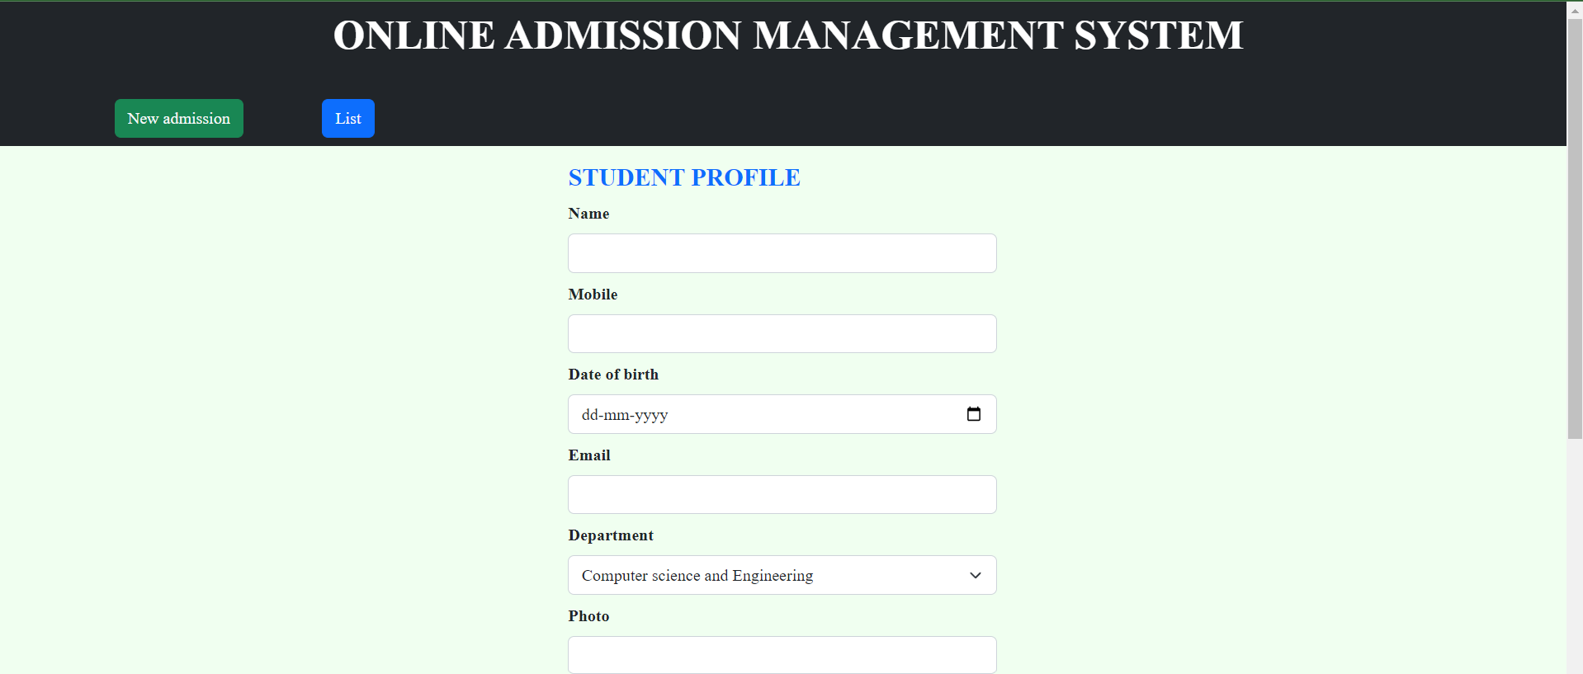
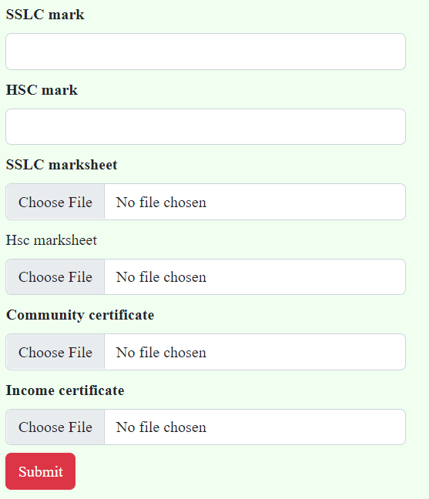
NEW ADMISSION PAGE

Slide 4
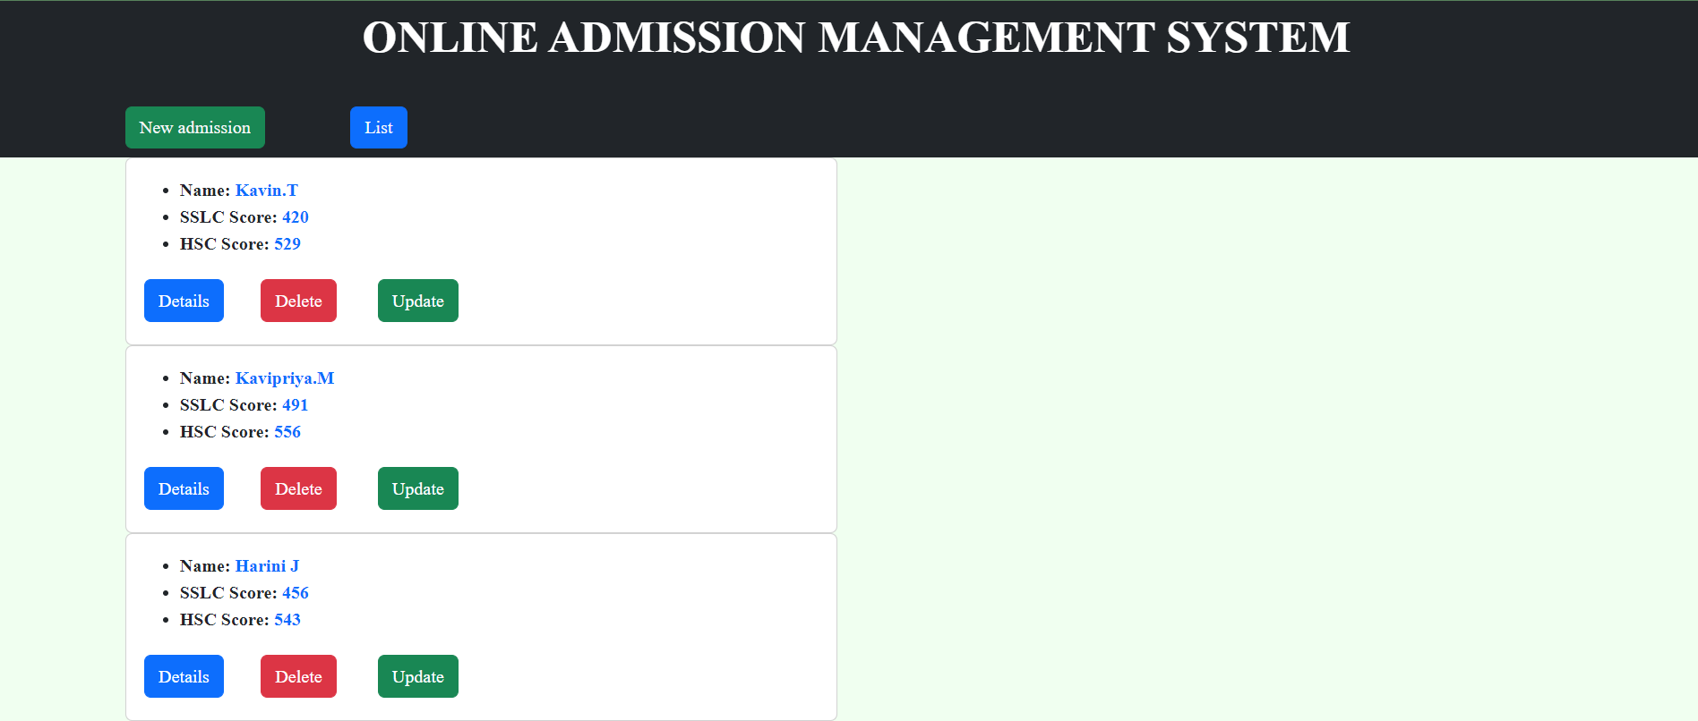
LIST OF STUDENTS

Slide 5
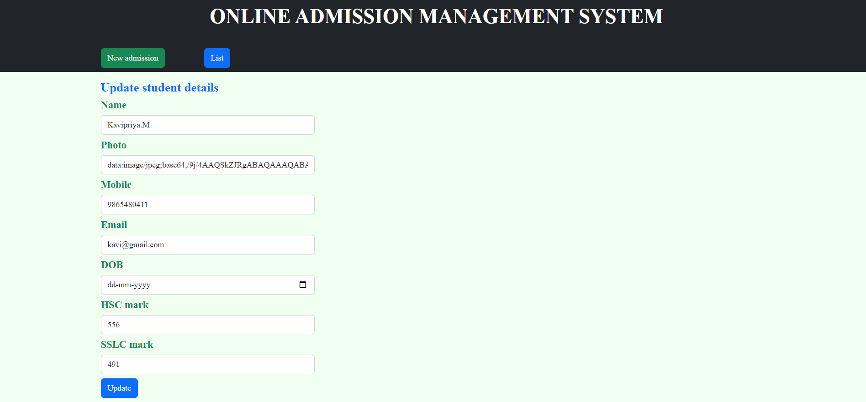
UPDATE STUDENT DETAILS FORM

Slide 6
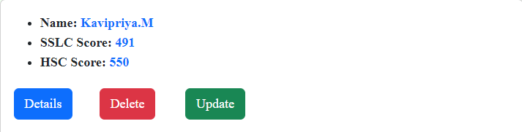
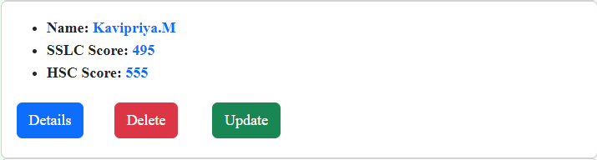
Before updating
After updating

Slide 7
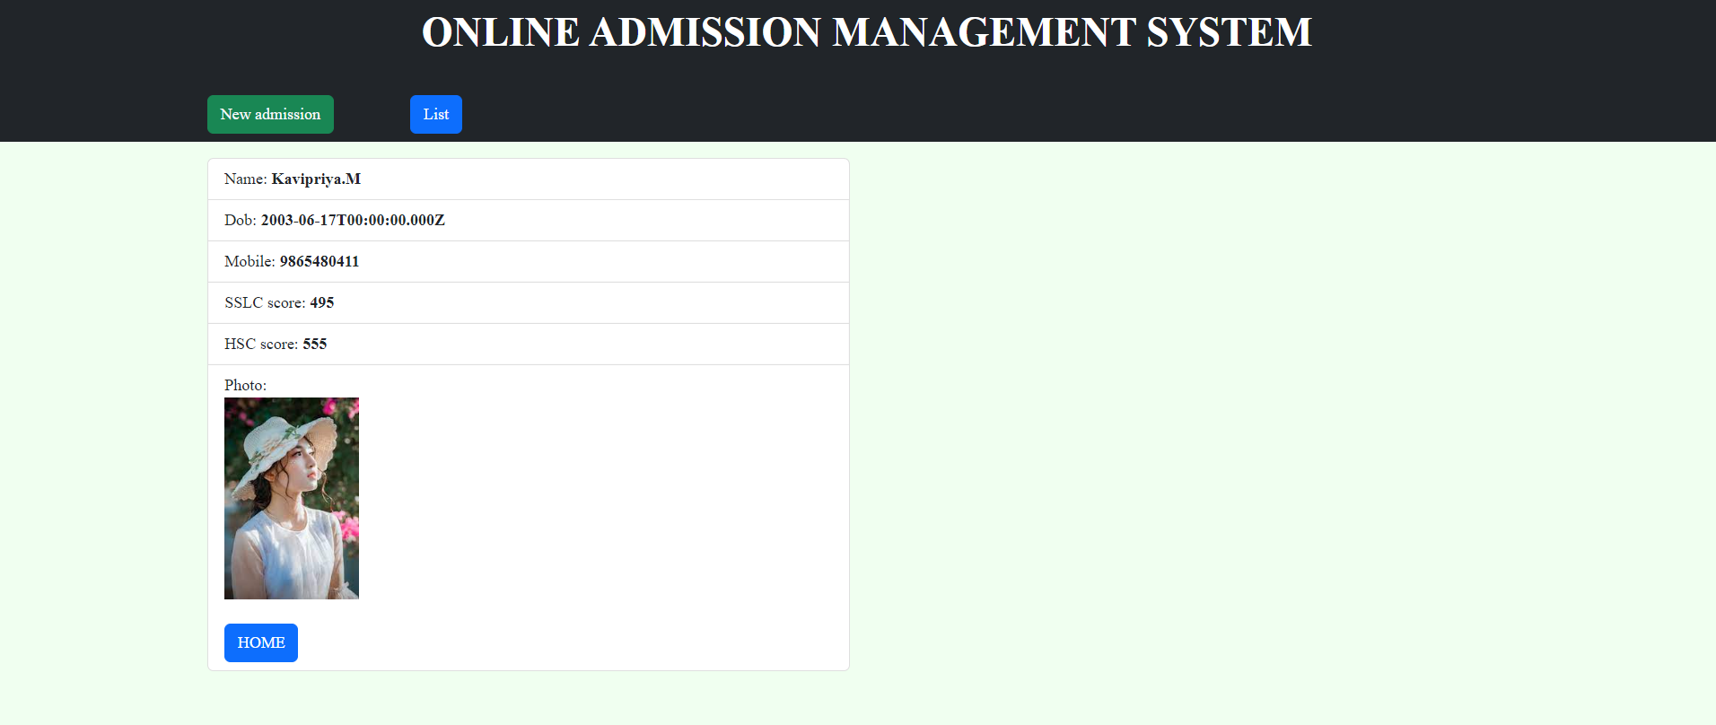
VIEW STUDENTS PROFILE

Slide 8
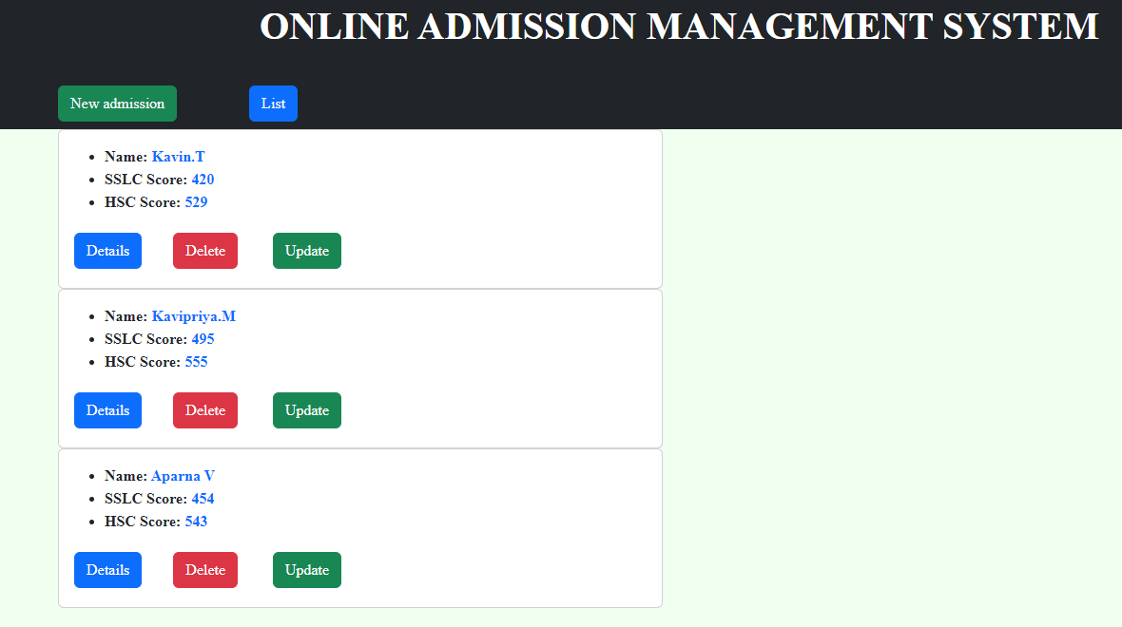
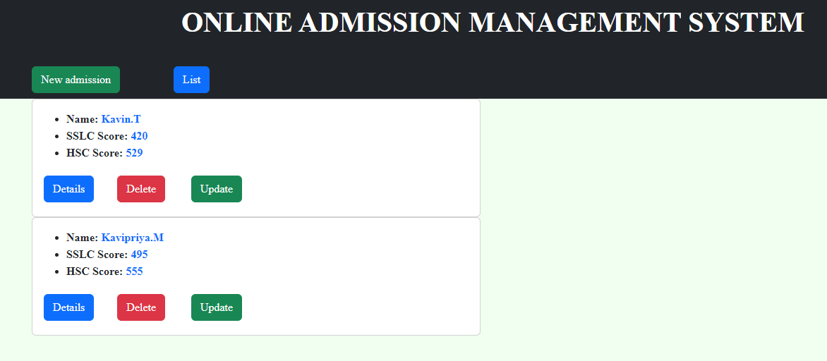
DELETE STUDENT DETAILS
Before deletion
After deletion

Slide 9

Github link: https://github.com/kavi1706/admission

